Slide 1

COVID 19
Ben, Dylan, Gianna & Nga

Slide 2
Introduction
Why: We are looking to explore the relationship between covid case numbers and vaccination rates, both locally in Victoria and internationally.

Slide 3
Hypothesis 1

Slide 4
Hypothesis 1
LGA's with a worse covid experience (higher case numbers) would be more motivated to get vaccinated and would therefore have higher vaccination rates.

Slide 5
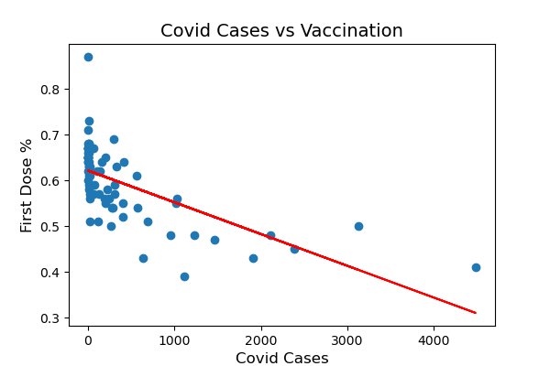

Slide 6
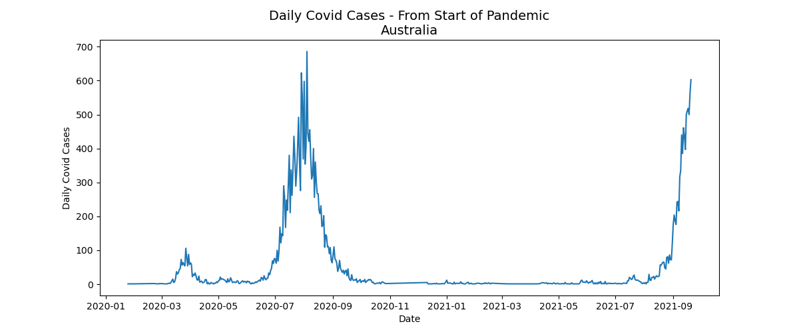

Slide 7
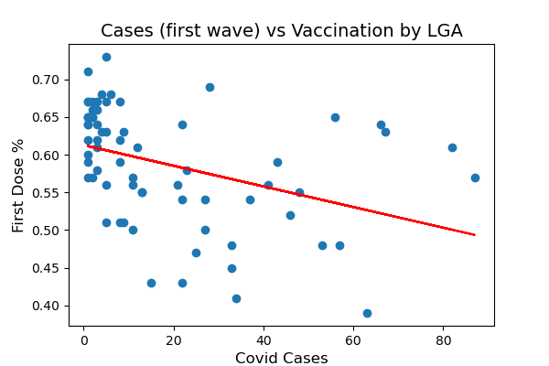

Slide 8
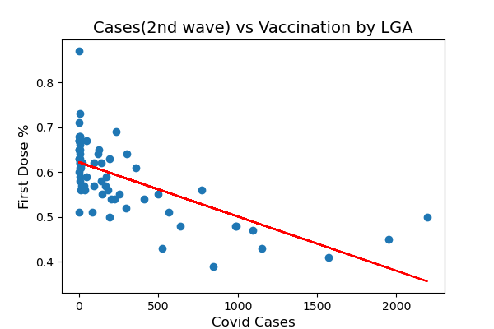

Slide 9
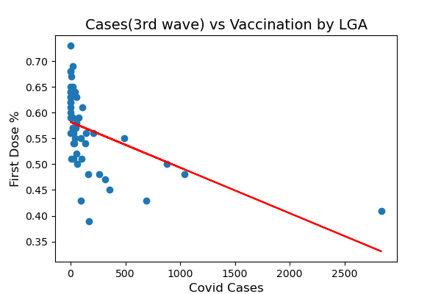

Slide 10
Hypothesis 2

Slide 11
Hypothesis 2
We should expect to see a decline in covid cases if there are higher rates of vaccination for the following age groups:
20-29
30-39
40-49
10-19

Slide 12
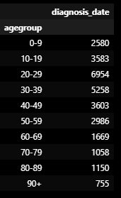
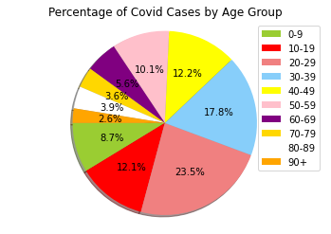

Slide 13
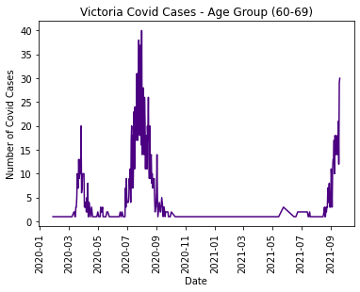
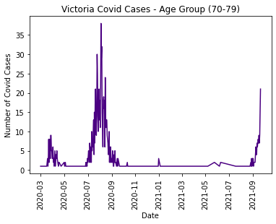
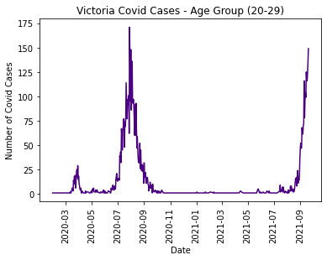
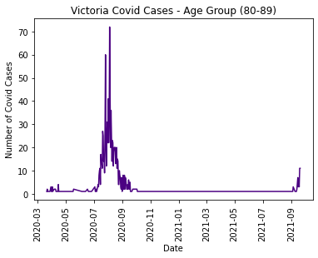
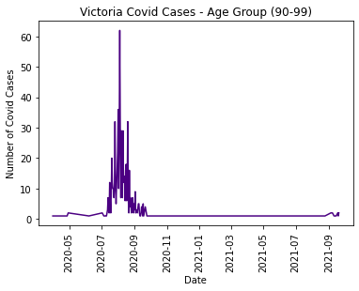
Victoria Covid –19 Cases Age Group (20-29) vs (Over 60s)

Slide 14
Age Group Population Per LGA
The LGA with the most concentration of affected age groups resides in the following municipalities:
Age Group
20-24 (Melbourne, Casey, Monash)
25-29 (Melbourne, Casey, Moreland)
30-34 (Casey, Wyndham, Melbourne)
35-39 (Casey, Wyndham, Whittlesea)
40-44 (Casey, Wyndham, Whittlesea)
45-49 (Casey, Wyndham, Greater Geelong)

Slide 15
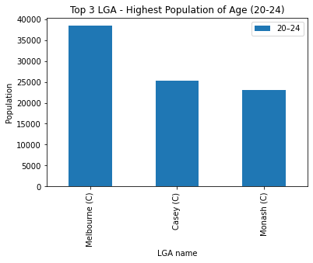
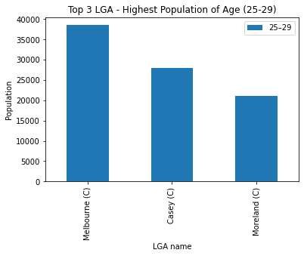
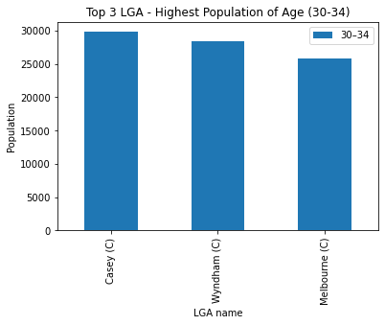
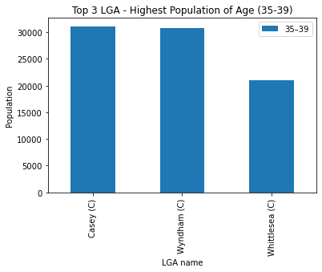
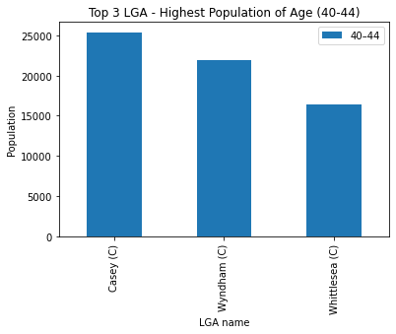
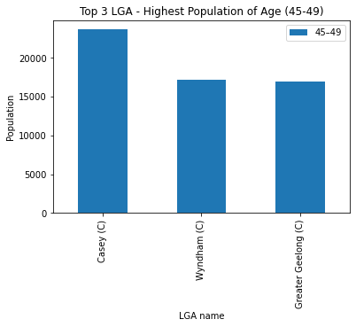

Slide 16
Summary
Victorian Government vaccination campaigns should be targeted towards these age groups in their respective LGA.
Different marketing tools and strategies should be applied to the various age groups in order to effectively deliver the message to the target audience:
Facebook active users worldwide are women aged (18-24 years) & men (25-35 years)
Instagram global audience aged between (25-35 years)
Pinterest aged between (30-49)
The Herald Sun aged between (18-49)
Commercial Radio listeners ( 55+ (28%), 40 – 54 (26%), 25-39 (27%), 15-24 (19%)

Slide 17
Data Limitations
The Vaccination Program has only been available for 16-39 year olds from 30th of August 2021 unless classified as an essential work or carer.
Data on daily vaccination numbers specific to LGA and age group are currently not available.

Slide 18
Hypothesis 3

Slide 19
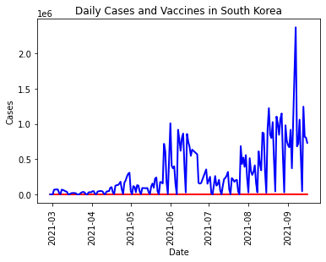
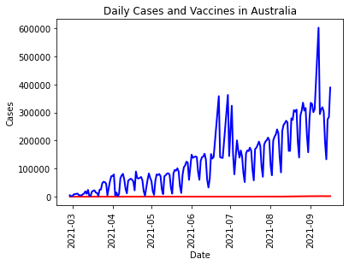
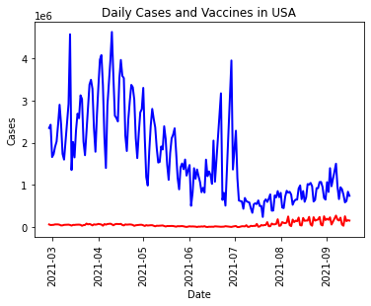
Daily Cases and Vaccines

Slide 20
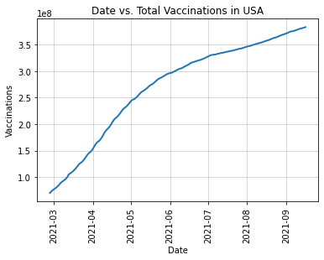
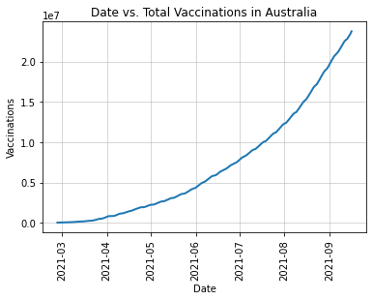
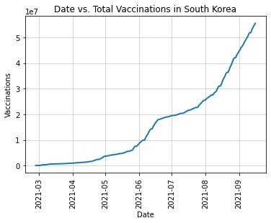
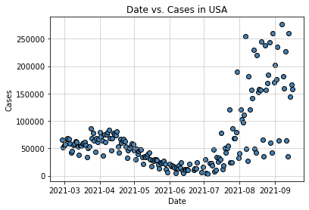
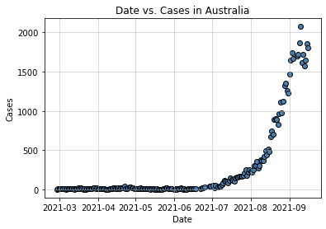
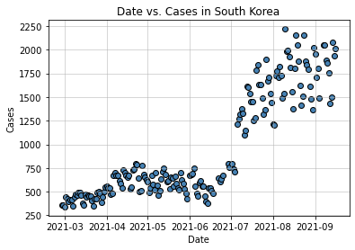

Slide 21
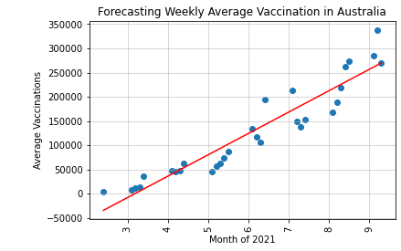
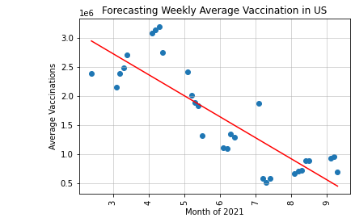
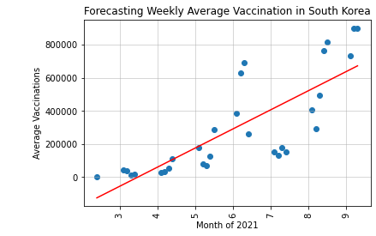
Forecasting Weekly Average Vaccination
SKr forecast equation y = 115648.01x + -402438.18 The average weekly vaccinations in October Week 1 will be 754,041.92
Aus forecast equation y = 44143.52x + -140748.4 The average weekly vaccination in October Week 1 will be 300,686.8
US forecast equation = y = -361363.14x + 3813973.71 The average weekly vaccination in October Week 1 will be 200,342.31
SKr forecast equation y = 115648.01x + -402438.18 The average weekly vaccinations in October Week 1 will be 754,041.92
6:29
Aus forecast equation y = 44143.52x + -140748.4 The average weekly vaccination in October Week 1 will be 300,686.8
New
6:32
US forecast equation = y = -361363.14x + 3813973.71 The average weekly vaccination in October Week 1 will be 200,342.31

Slide 22

Data Source

Slide 23
Data Source
ABS stats by LGA - https://dbr.abs.gov.au/
Department of Health - https://www.health.gov.au/resources/collections/covid-19-vaccination-geographic-vaccination-rates-lga
World Health Organisation - https://github.com/owid/covid-19-data/tree/master/public/data
Victoria Government - https://www.coronavirus.vic.gov.au/victorian-coronavirus-covid-19-data

Slide 24
How the data was found
Data format (CSV)
Data retrieved 16/9/21 – 22/9/21
Data was retrieved through downloading directly from the data source
Researching through search engines

Slide 25
Data Wrangling Process
Removed null values
Converting data types – changing from object to date time
Joining / merging dataset on date
Reset indexes
Creating new data frames
Normalising values by classifying dates as values

Slide 26
Limitations
Finding data that is available and reliable was an obstacle as it was difficult to find a trend and draw a correlation between two variables without specific data. E.g. Vaccination rates per LGA over time.
API not required as necessary data was only available in CSV format.

